Slide 1
Biodiversity Project
Elaine Wu
Codecademy

Slide 2
About the Dataset
Two datasets, observations and species_info
Observations: tells the number of observations of each species at the national parks Great Smoky Mountains, Yosemite, Bryce, and Yellowstone; 69888 rows, 3 columns
Species_info: tells the conservation status of each species; 5824 rows, 4 columns
Share the scientific_name column
Each park has the same number of rows.

Slide 3


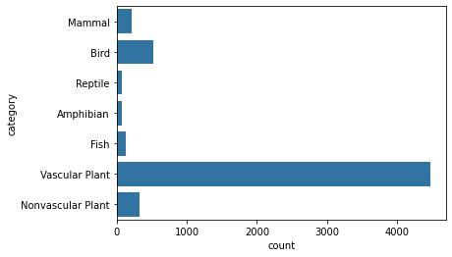

Distribution of Categories
Each park has the same number of species.
Each park has the same distribution of the categories, e.g., each park has the same number of mammals.
4470 vascular plants, more than eight times the next-leading category, birds

Slide 4
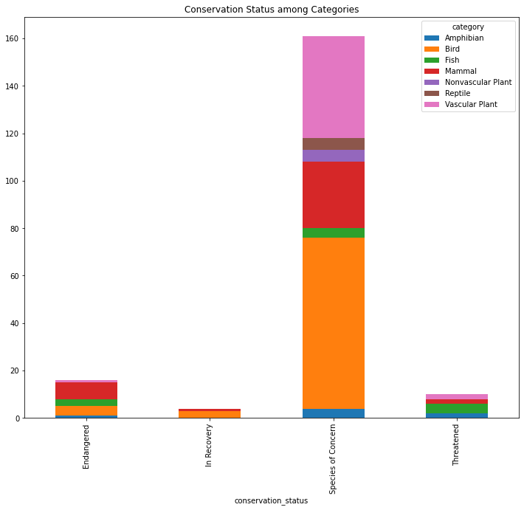
Categories and Conservation Status
Notice that there are about 160 species of concern, most of which are birds and vascular plants.
Notice that the most endangered category is mammal!
Most of the species in recovery are birds.
The most threatened category is fish.

Slide 5
Which species are most abundant in each park?
Great Smoky Mountain: Sonchus asper ssp. Asper, i.e., Spiny Sowthistle, a vascular plant, w/ 147 observations
Yosemite: Ivesia shockleyi var. shockleyi, i.e., Sky Mousetail, a vascular plant, w/ 223 observations
Bryce: Valerianella radiata, i.e., Beaked-corn salad, a vascular plant, w/ 176 observations
Yellowstone: Lycopodium tristachyum, i.e., Ground Cedar, a vascular plant, w/ 321 observations

Slide 6
Recommendations
Since a large fraction of endangered species are mammals, I would recommend working on preserving mammals.
I would recommend increasing the number of mammal species that are in recovery, as it appears that no mammal species are in recovery.
There are more species of birds of concern than species of vascular plants of concern. Think about why. Although there seems to be some bird species in recovery, I would recommend staying vigilant such as to prevent bird species from becoming threatened as well as reduce the number of bird species of concern.

Slide 7
Conclusion
Although vascular plant species constitute the most wildlife, it is one of the lesser endangered category.
The category of the most concern is birds.
The most endangered category is mammals.

